Slide 1
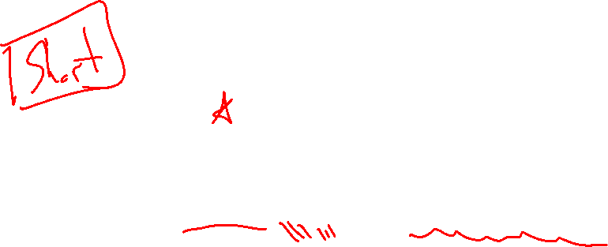
Section 1.1 Introduction
Lecture 1
Precision, error, and minimizing operations
Notes:
Section is shorter than most

Slide 2
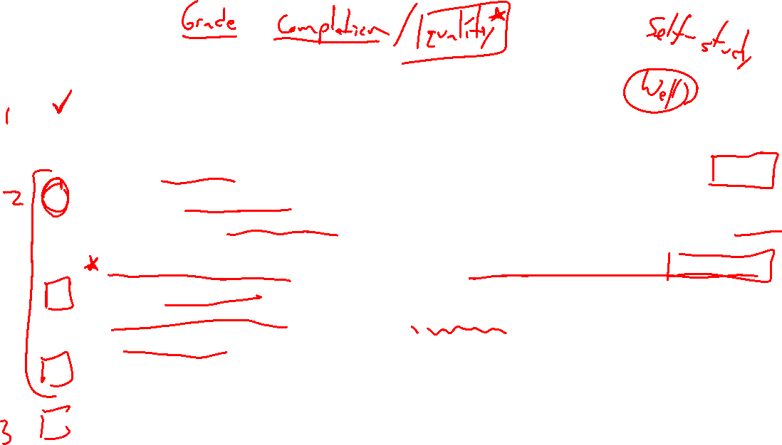
Homework Submission to Canvas
Preview of section
Skim the section in text and write a short paragraph summary.
Give a bulleted list of all important definitions, theorems, and formulas without details.
Notes on video lectures
Take notes on everything written on slides including all details, worked examples, on-own activities, as well as your own thoughts and questions.
Try on-own activities first, then write down provided solution next to it for comparison.
Worked examples from the text
Write down the problem and attempt without looking at the solution.
Use the solution to write the best explanation you can.
Solutions to textbook exercises
Model approaches and explanations given in the video lectures and textbook examples.
Final reflection of section
List the key takeaways to remember as a bulleted list.
Notes:
Mention graded for completion and quality of writing.

Slide 3
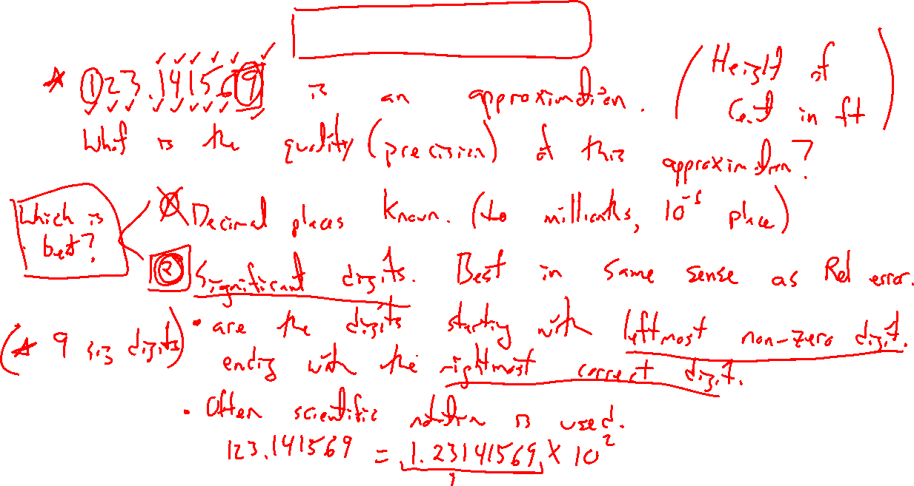
Precision and significant digits
Notes:
Centennial height is 80 ft rounded to the nearest 10s of feet.
Def: Sig digits are the digits starting with leftmost non-zero digit ending with the rightmost correct digit (7 above)
Scientific notation makes this a bit standard (all digits after decimal)
80 = 0.8 x 10^2

Slide 4
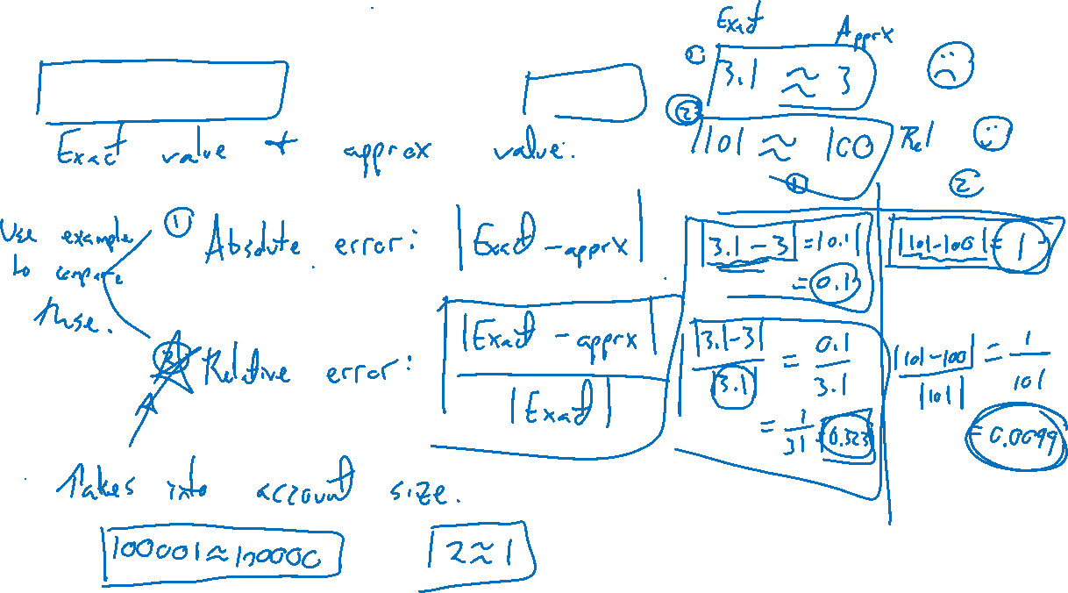
Try on own: Measuring error
Notes:
Absolute error |exact – apprx|
Relative error |exact – apprx|/|exact|
What is the differenct? Illustrate purpose with own example.
Exact = 1 (0.1), approx = 1.1 (0.2)

Slide 5
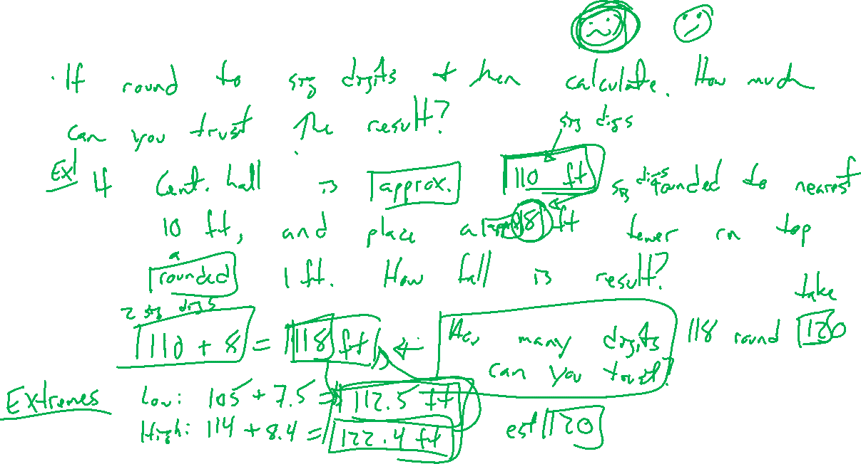
Accuracy and significant digits
Notes:
Centennial is 80ft to the 10s of feet. You put a tower on top which is 6ft rounded to nearest foot.
How tall is result?
80+6 = 86, looks like accurate to 2 sig digits. In fact, only can trust one (after rounding).
86 = 90 ft to 10s of feet
Look at extremes (75+5.5 = 80.5), (84+6.4 = 90.4), middle is above 85 so rounding to 90 is there.
Rule of thumb is only as good as least accurate value. Weird, will see more in HW

Slide 6
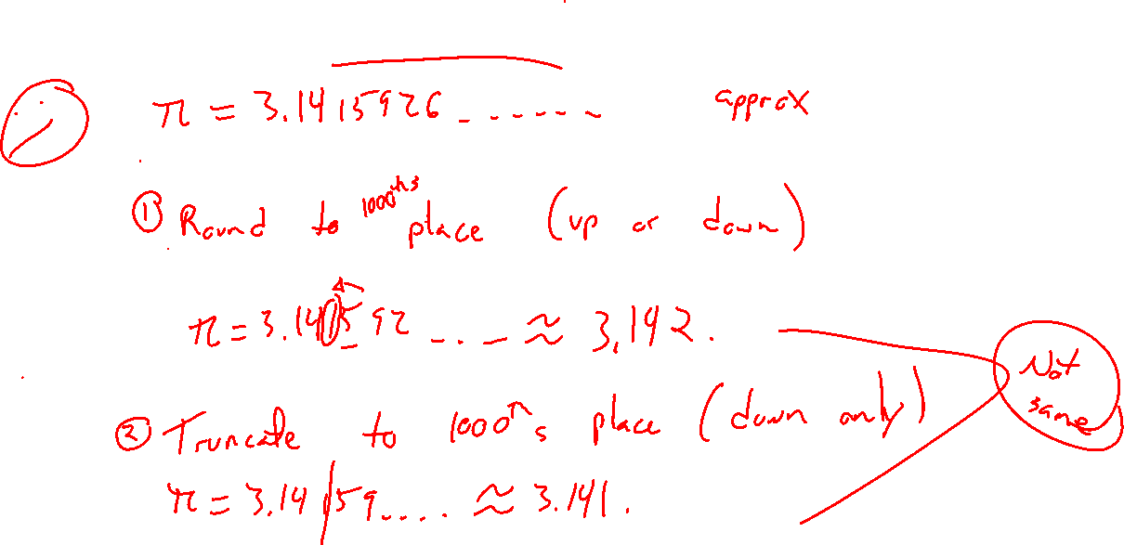
Rounding vs chopping
Notes:
Terminology, easy.

Slide 7
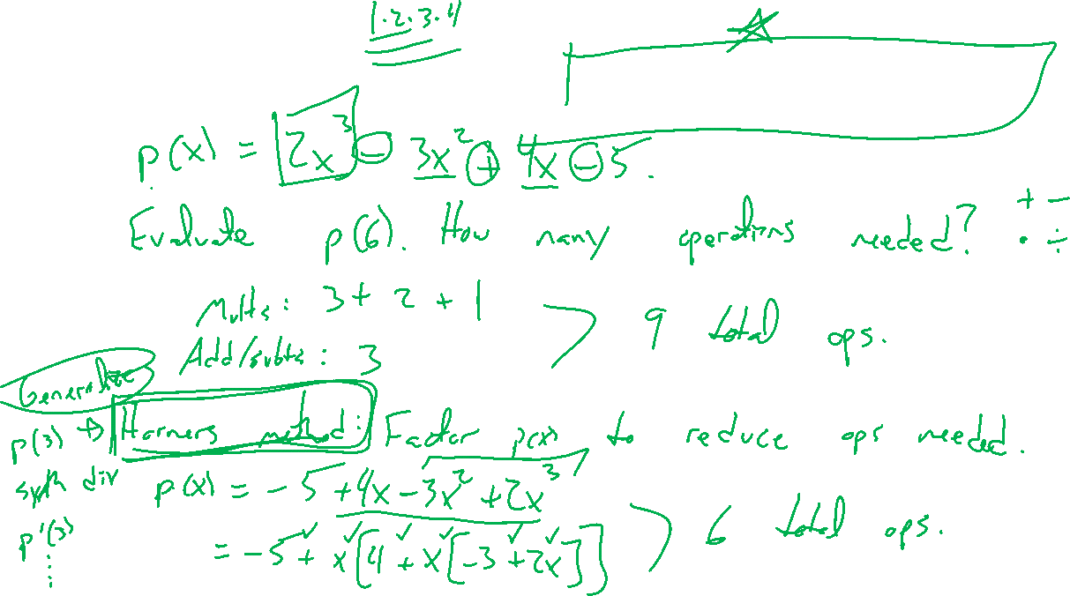
Polynomial evaluation: Nested multiplication
Notes:
How many operations (+-x) are needed to compute p(3)?
P(x) = 2x^3+6x^2-6x-18 (9 total)
To avoid accumulating roundoff error, reduce and count needed ops.
P(x) = -18+x(-6+x(6+2x))) (6 ops).
General for degree n poly.

Slide 8
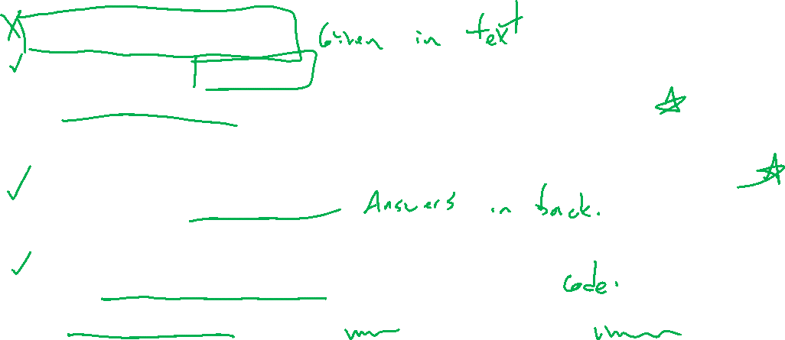
Section 1.1: Textbook Examples and Exercises
Theorem proofs: None
Text examples 2, 3, 4, 6.
Write down a problem. Close the book and attempt on own.
Check / correct your solution against the text solution.
If needed, rewrite the problem to be of the quality of the text solution.
Text exercises 1, 2, 3, 8, 16.
Write solutions of the same quality as in lecture and text solutions.
Text computer exercises 1, 2, 3, 9, 10.
Record screenshots of your script and corresponding outputs.

Slide 9

Homework Submission to Canvas
Preview of section
Skim the section in text and write a short paragraph summary.
Give a bulleted list of all important definitions, theorems, and formulas without details.
Notes on video lectures
Take notes on everything written on slides including all details, worked examples, on-own activities, as well as your own thoughts and questions.
Try on-own activities first, then write down provided solution next to it for comparison.
Worked examples from the text
Write down the problem and attempt without looking at the solution.
Use the solution to write the best explanation you can.
Solutions to textbook exercises
Model approaches and explanations given in the video lectures and textbook examples.
Final reflection of section
List the key takeaways to remember as a bulleted list.
Notes:
Mention graded for completion and quality of writing.

